Slide 1
Journey PPT
Shell Training
Week 2 – 21/8/2023 to 25/8/2023
Gaurav Singh
Associate Data Engineer

Slide 2


Day 1 -
Introduction to Business Analysis
Requirement Analysis – Functional and Non-Functional
Requirement Traceability
Project Management Basics
Waterfall Model vs Agile Model
Introduction to Agile Practices
Everything about sprint
Roles in Agile
Hands on MS DevOps – Creating User Stories, Epics, Tasks, Features, Issues, Tests etc.

Slide 3
Day 2 -
DBMS
SQL Basics
SQL vs No-SQL
DDL, DML, DQL, DCL, TCL
Normalization – 1NF, 2NF, 3NF, BCNF
Joins
Sub-Queries
Hands on: SQL queries for creating tables, inserting data, manipulation of data, retrieval of data, analyzing of data

Slide 4
Day 3 -
Software Testing
Importance of Testing
Testing vs Development
Software Test Life Cycle
Phases of STLC
SDLC vs STLC
Testing Triangle
Black Box Testing vs White Box testing vs Gray Box Testing
Unit Testing vs Integration Testing
Behavior Driven Development (BDD)

Slide 5
Day 4 -
DevOps
DevOps Life Cycle
DevOps Tools
DevOps Stages
CI CD

Slide 6
Day 5 -
Cloud Computing
What is Cloud
Computing Advantage & Disadvantage
History of Cloud
Cloud Computing Architecture
Cloud Computing Technologies
Cloud Computing vs Grid Computing
How Cloud work
Cloud Computing Applications

Slide 7
Thank you for your time.

Slide 9
Journey PPT
Shell Training
Week 3 – 28/8/2023 to 09/9/2023
Gaurav Singh
Associate Data Engineer

Slide 10
Day 1 -
Agile, Business Analysis Case Study
Implemented a seamless CI/CD workflow for a Spring Boot application
Technology Used – Spring Boot, Azure Portal, Azure Boards, Azure, Git, Maven, Docker, Github, Github Actions.

Slide 11
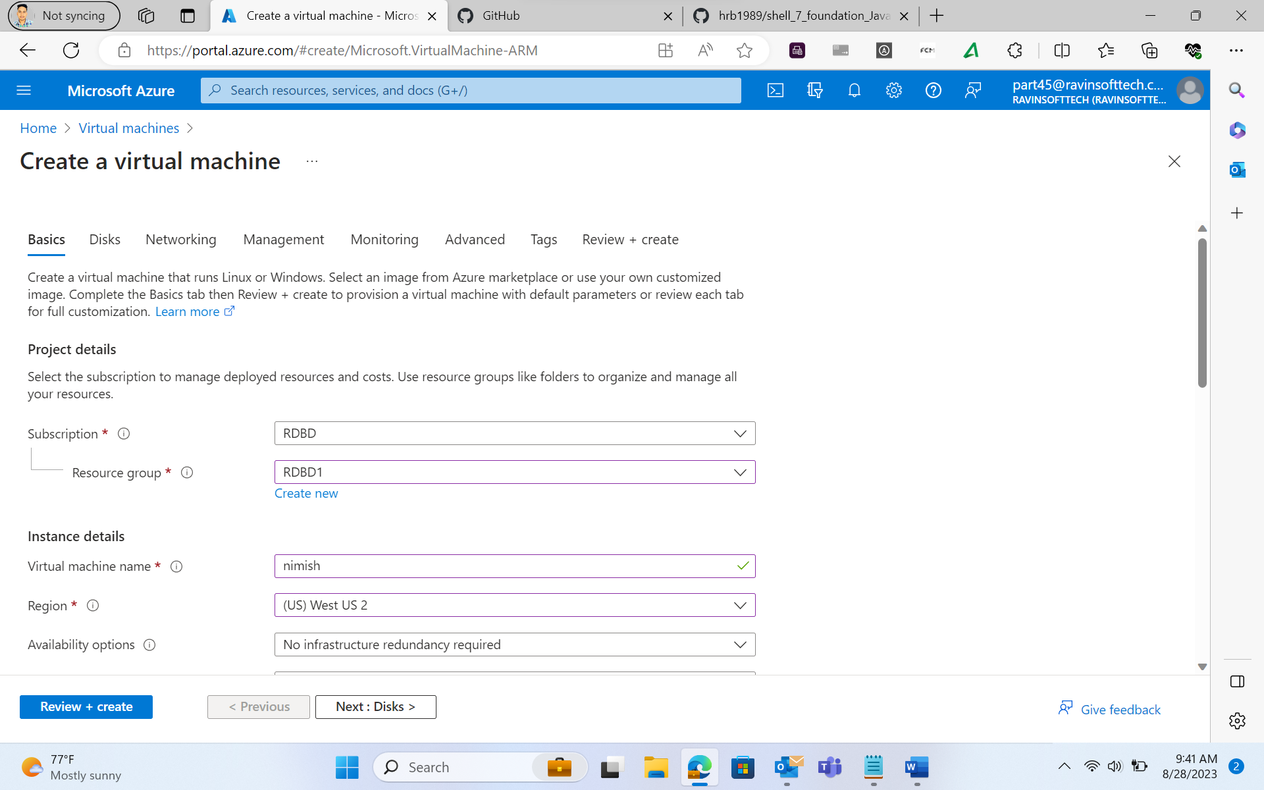

Slide 12
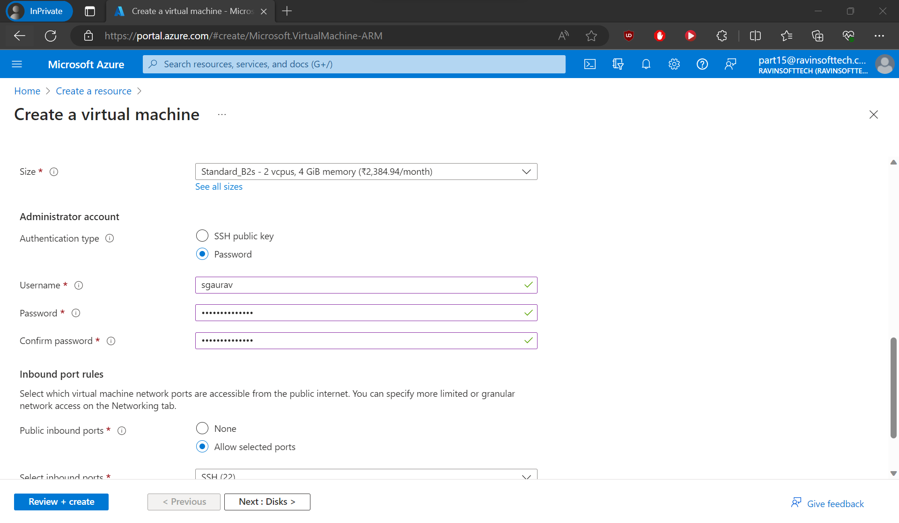

Slide 13
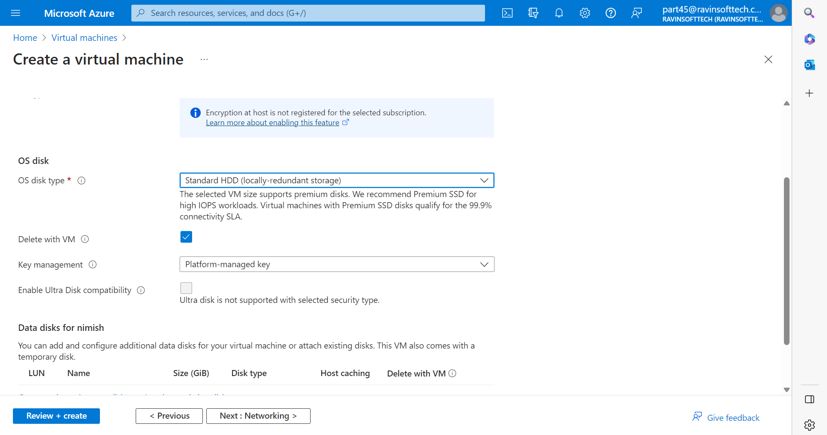

Slide 14
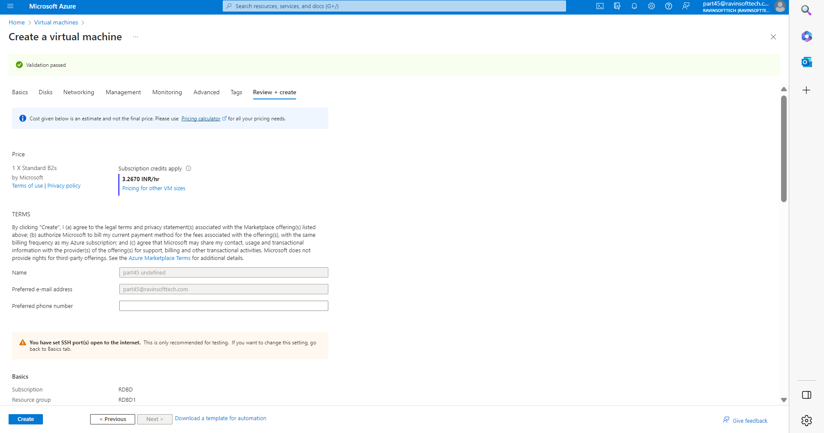

Slide 15
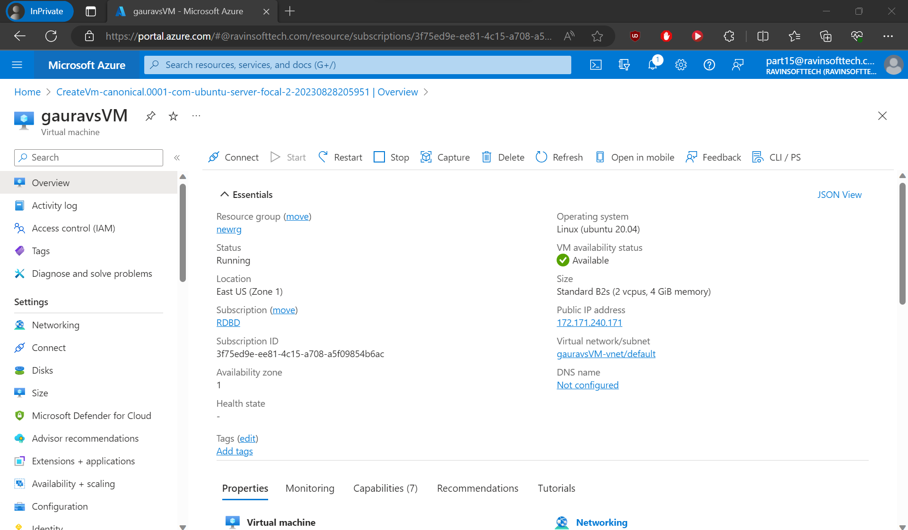

Slide 16
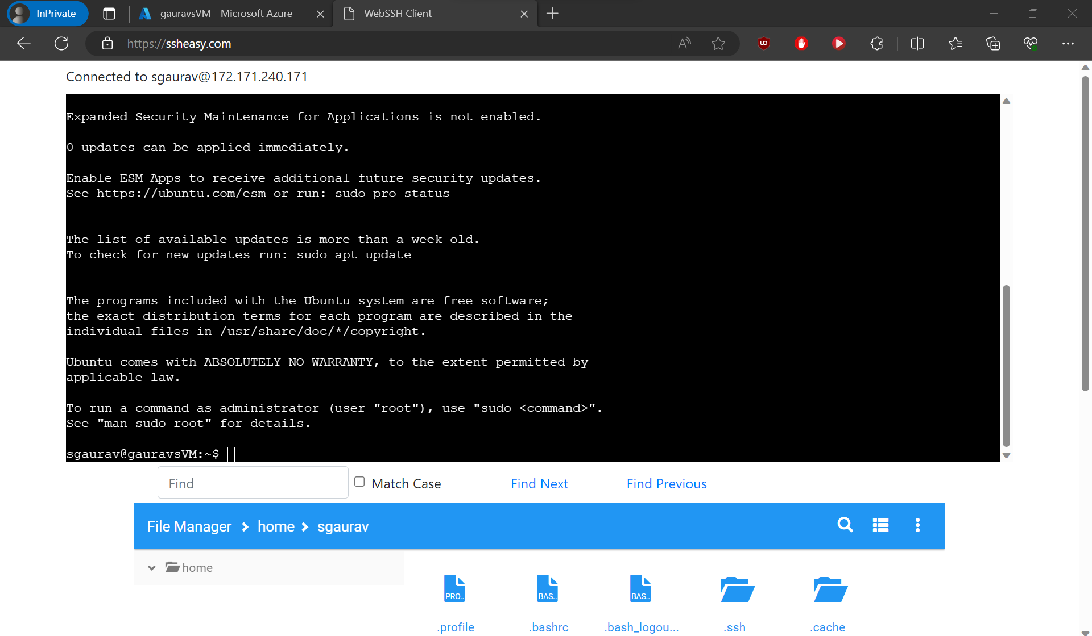

Slide 17
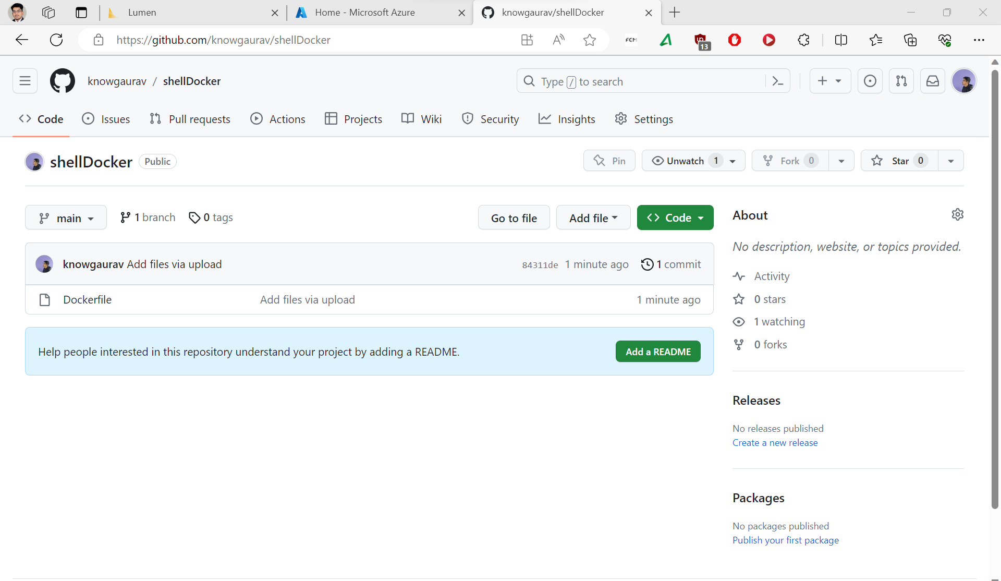

Slide 18
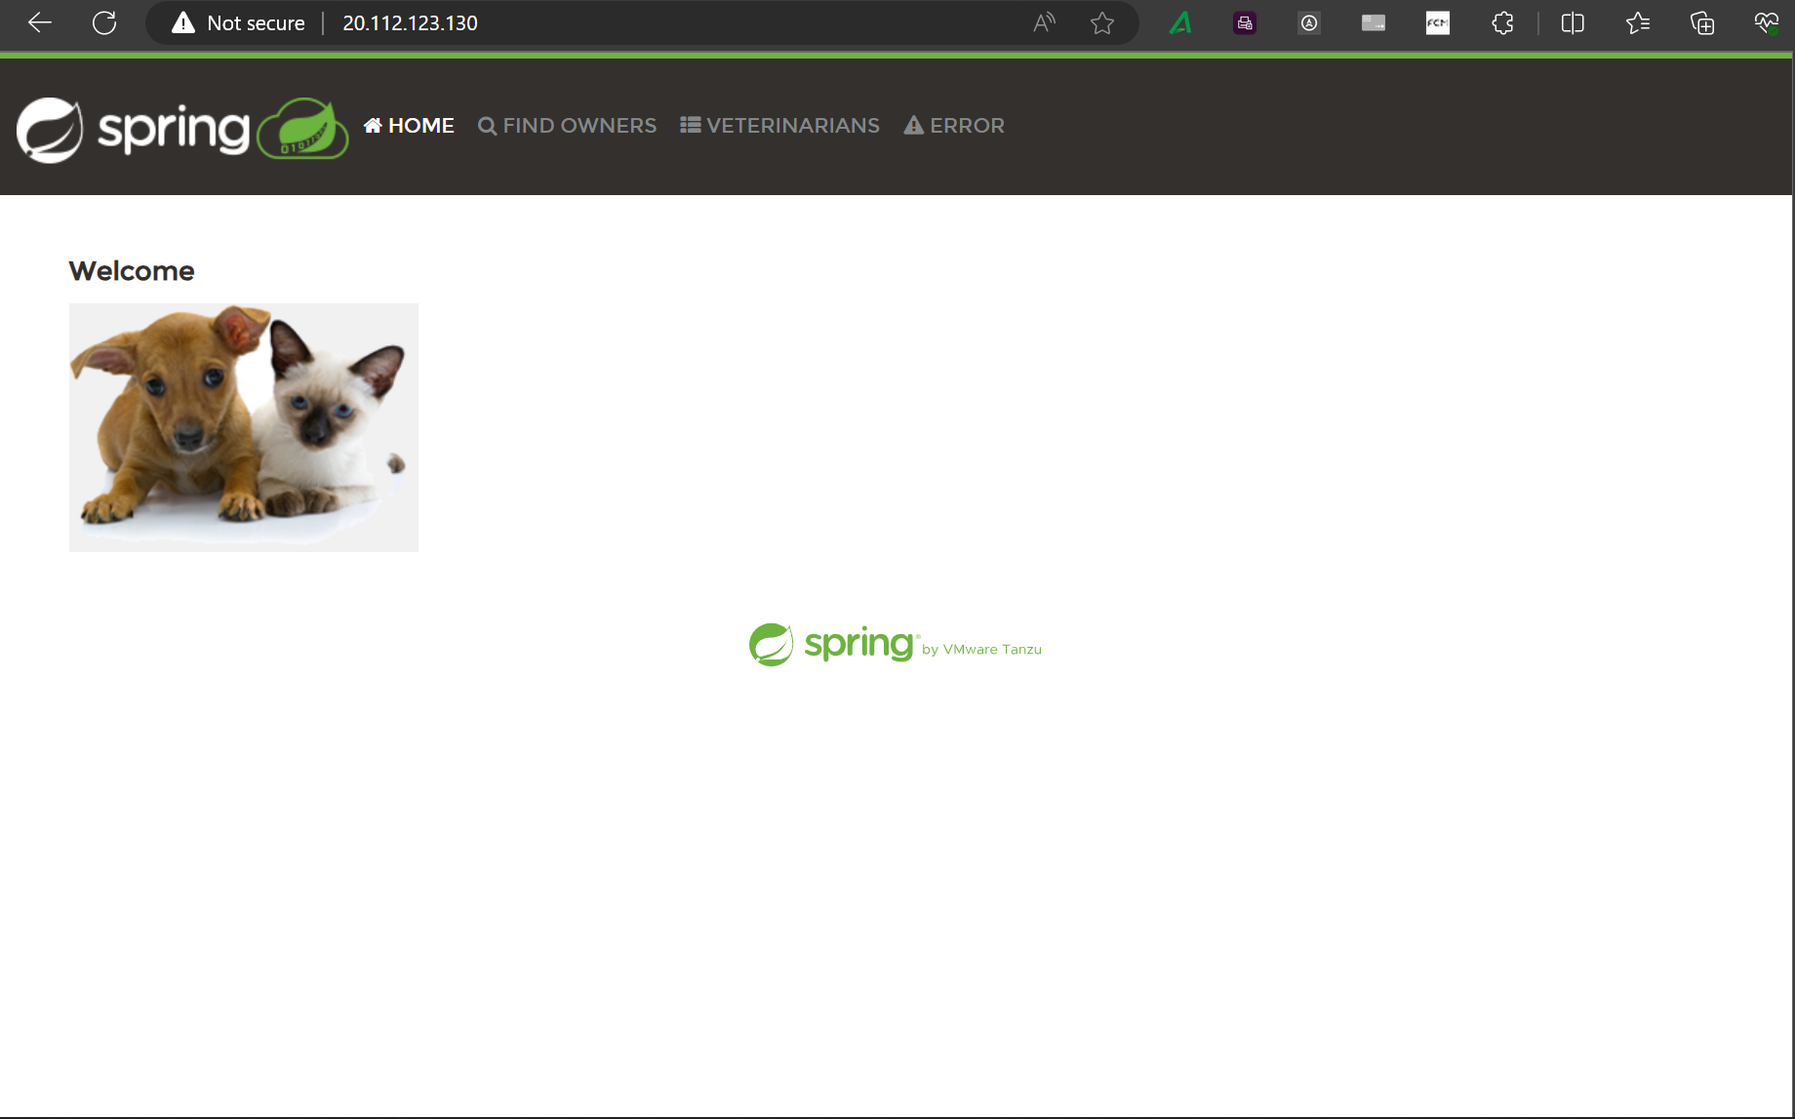

Slide 19
Day 2 -
Data Warehouse Components
Operational Database Vs Data Warehouse
Data Warehouse Architecture
Three-Tier Data Warehouse Architecture
What is Meta Data
What is Data Mart
Delivery Process

Slide 20
Day 3 -
ETL vs ELT
Types of Data Warehouses
Data Warehouse Modeling
Data Warehouse Design
Data Warehouse Implementation
What is Star Schema?
What is Snowflake Schema?
Star vs Snowflake Schemas
Process Architecture
Types of Database Parallelism
Data Warehouse

Slide 21
Day 4 -
Microsoft Azure Tutorial
Microsoft Azure Tutorial
Cloud Computing Overview
Azure Portal
Azure Database service
Azure SQL Database
SQL Database Configuration
SQL Managed Instance
Azure COSMOS DB
Azure Data Factory
SQL Data Warehouse

Slide 22
Day 5 -
Lumen Assessment / MCQ Quiz
SQL JOIN, SQL Outer Join, SQL Left Join, SQL Right Join, SQL Full Join, SQL Cross Join
SQL Subquery
Chasm and Fan Traps

Slide 23
Thank you for your time.

